Slide 1
Project Charter Infographics
Here is where this template begins

Slide 2
Project Charter Infographics
Project description & milestones
Neptune
01
Neptune is the farthest planet from the Sun
Mercury is the closest planet to the Sun and the smallest one
Project director
Mars
02
Name 1
Despite being red, Mars is a cold place
Project manager
Name 2
Team manager
Pluto
03
Name 3
Pluto is considered a dwarf planet

Slide 3
Project Charter Infographics
Goals
Scope
Team
55%
In
Diretor
Mercury
It’s the farthest planet from the Sun
Name 1
Manager
45%
Out
Name 2
Venus
Despite being red, Mars is a cold place
Recruiter
Name 3

Slide 4
Project Charter Infographics
Business case
Project director
Risk definition
Name 1
Mercury is the closest planet to the Sun and the smallest one
Jupiter is a gas giant and the biggest planet in the entire Solar System
Authority
Sponsors
3/5
10%
90%
Mercury
Venus
Jupiter
Project manager
Name 2
$180K
Initial budget
Authority
2/5
Mercury
Jupiter

Slide 5
Project Charter Infographics
Project title
Project scope
Assumptions/ Constraints
Despite being red, Mars is a very cold place full of iron oxide dust
Problem statement
Goals
Mercury is the closest planet to the Sun and the smallest one
Jupiter is a gas giant and the biggest planet in the entire Solar System
Team organization
Venus
Mars
Neptune
Mercury
Ceres
55%
45%
Jupiter
Pluto
Mars
Venus

Slide 6
Project Charter Infographics
Project title
Week 1
01 | 02 | 03 | 04 | 05 | 06 | 07
Description
Task 1
Mercury is the closest planet to the Sun and the smallest one
Task 2
Task 3
Project manager
Milestones
Purpose
Name 1
Venus has a beautiful name
1
2
3
Saturn is a gas giant composed mostly of hydrogen and helium
Team manager
Name 2
Despite being red, Mars is a cold place
It’s a gas giant and the biggest planet

Slide 7
Project Charter Infographics
Goals
Team
Timeline
01
Mercury
Project director
1
Jupiter
Mercury is the closest planet to the Sun
Name 1
Jupiter is a gas giant
Project manager
02
Mars
Name 2
2
Pluto
Despite being red, Mars is a cold place
It’s a dwarf planet
Team manager
Name 3
3
Earth
Scope
Business case
Earth harbors life
Saturn is a gas giant composed mostly of hydrogen and helium
Venus a beautiful name, but also very high temperatures
4
Saturn
It has a lot of rings

Slide 8
Project Charter Infographics
Project title | Portfolio management tool design and development
Start date | May 21, 2022 | End date | June 23, 2023
Budget to complete this project is
$3,000
Business need | Mercury is the closest planet to the Sun and the smallest one of all the planets in the Solar System
Project team
Project manager | Name 1
Team manager | Name 2
Creative director | Name 4
Approval committee
Sponsor | Name 1
Business head | Name 2
Finance manager | Name 4

Slide 9
Project Charter Infographics
Project title
Mercury is the closest planet to the Sun and the smallest one in the Solar System
Project manager
Deliverables
Despite being red, it’s cold Venus has a nice name
Name 1
Team manager
Name 2
Milestone 1
Milestone 2
Milestone 3
Mar 15
June 17
Oct 13
Jan | Feb | Mar | Apr | May | June | July | Aug | Sep | Oct | Nov | Dec

Slide 10
Project Charter Infographics
Statement of work
What is it?
A project contract
Purpose
Addresses the business need
Content
Scope, deliverables, assumptions…
Project charter
What is it?
A document based on the SoW
Purpose
Gives authority to the PM
Content
Why? Who? What? When?…
Statement of work
Vs
Project charter

Slide 11
Project Charter Infographics
Project charter
Project title | Mercury is the closest planet to the Sun and the smallest one in the Solar System |  |  | Project manager | Name 1
Start date | May 19, 2021 | End date | June 21, 2021 | Project sponsor | Name 2
Business needs |  | Yes, Saturn is a very big gas giant with several rings around it and it's composed for the most part of hydrogen and helium
Project scope |  |  | Deliverables
Venus has a beautiful name, but its atmosphere is extremely poisonous |  |  | Jupiter is a huge gas giant named after the Roman god of the skies and the lightning
Risks and issues |  |  | Assumptions and dependencies
Earth is the third planet from the Sun and the only one that harbors life in the Solar System |  |  | Mars is a cold place full of iron oxide dust, which gives the planet its reddish cast

Slide 12
Project Charter Infographics
Deliverables
Earth harbors life Venus is a cold place Saturn is the ringed one
Risk 1
Risk 2
Risk 3
Despite being red, Mars is a cold place
Venus has a beautiful name
Risk level
Risk level
Risk level
It’s a gas giant and the biggest planet
3/5
2/5
4/5
Milestones schedule
Milestone | Target end date | Current date
Mercury is the closest planet to the Sun | May 19, 2023 | May 12, 2022
Mars is a cold place full of iron oxide dust | July 12, 2023 | May 12, 2022

Slide 13
Project Charter Infographics
Project name | Despite being red, Mars is a cold place
Description & goals | Venus is the second planet from the Sun
Project leader | John Doe
Project sponsor | Helena James
Project manager | Juliette Parker
Scope | In | Earth is the planet that harbours life
 | Out | Saturn is a gas giant with rings
Constraints | Time | Pluto is now considered a dwarf planet
 | Budget | Ceres is located in the main asteroid belt
 | Quality | Jupiter is the biggest planet of them all
 | Scope | Mercury is the smallest planet
Estimated budget | $8,540
Key resources | Venus Mercury Mars

Slide 14
Project Charter Infographics
Project name
Saturn is a gas giant and has several rings. It's composed mostly of hydrogen and helium
Key milestones
May 21, 2022 | Venus has a nice name
June 23, 2022 | Mars is a very cold planet
July 16, 2022 | Jupiter is the biggest planet
August 12, 2022 | Mercury is the smallest one
September 11, 2022 | Yes, Saturn is the ringed one
Project Goals
Project approval
May 20 2021 | Earth is the one that harbors life
25%
Mercury
75%
Venus

Slide 15
Project Charter Infographics
Opportunity assessment
Market analysis
Transition management
Ongoing operations
Key activities
Activity 1 Activity 2 Activity 3 | Activity 4 Activity 5 Activity 6 | Activity 7 Activity 8 Activity 9 | Activity 10 Activity 11 Activity 12
Deliverables
Mercury is the closest planet to the Sun and the smallest one in the entire Solar System |  | Mars is a cold place full of iron oxide dust, which gives the planet its reddish cast

Slide 16
Project Charter Infographics
Objectives
Principles
Mercury is the closest planet to the Sun and the smallest one
Jupiter is a huge gas giant named after the Roman god of the skies
Out of scope
Saturn is a gas giant, composed mostly of hydrogen and helium
In scope
Team
Neptune is the fourth-largest planet in the Solar System
Mercury
Jupiter
Neptune
Venus
Earth
Pluto
Mars

Slide 17
Project Charter Infographics
Project overview
Project milestones
Budget
Mercury is the closest planet to the Sun and the smallest one of them all
Concept | Quantity | Price
Venus | 10 | $430
Mars | 5 | $100
Earth | 5 | $50
Moon | 15 | $10
Total | $7,050
1
Jupiter
Jupiter is a gas giant
Project name
Pluto
2
Mercury
It’s a dwarf planet
Lead project
Jupiter
Earth
3
Project start
It harbors life
12 May 2022
Location
4
Saturn
Earth
It has a lot of rings

Slide 18
Project Charter Infographics
Project name
Project manager
Summary
Mercury
Jupiter
Despite being red, Mars is a cold place
Project Schedule
July | 05 | 10 | 15 | 20
Requirement
Data
Layout
Prototype
Code
Goals
It’s the farthest planet from the Sun
Deliverables
Venus is the second planet from the Sun
Risks/issues
Pluto is considered a dwarf planet
Budget
Saturn is a gas giant with rings

Slide 19
Project Charter Infographics
Key phases
Initiation
Analysis
Design
Closure
Phase 1
Phase 2
Phase 3
Phase 4
Mercury is the closest planet to the Sun
Jupiter is a gas giant and the biggest planet
It’s the farthest planet from the Sun
Venus is the second planet from the Sun
Role name | Responsibility level | Main tasks
Manager |  | Yes, Saturn is the ringed one
Analyst |  | Earth is where we all live on
Designer |  | Despite being red, Mars is cold
4/5
3/5
2/5

Slide 20
Project Charter Infographics
Project overview
Mercury is the closest planet to the Sun and the smallest one of them all
Overview progress
70%
Project name
Project manager
Venus
Mars
Mercury
Jupiter
25%
75%
Budget | Quantity | Price
Venus | 10 | $430
Mars | 5 | $100
Total | $4,800

Slide 21
Project Charter Infographics
Project overview
Total Budget | $7,050
Mercury is the closest planet to the Sun and the smallest one of all the planets in the Solar System. This planet's name has nothing to do with the liquid metal, since Mercury was named after the Roman messenger god
Project milestones
May 24
Venus
Venus has a beautiful name
Project name
Lead project
Mercury
Jupiter
June 13
Neptune
Neptune is a gas giant
Project start
Location
12 May, 2022
Earth
July 30
Mars
Despite being red, it’s cold

Slide 22
Project Charter Infographics
Project title
Project risks
Mercury is the closest planet to the Sun and the smallest one of all the planets in the Solar System
Saturn is a gas giant and has several rings. It's composed mostly of hydrogen and helium
Progress
Progress
25%
70%
Project overview
Project team
Venus has a beautiful name and is the second planet from the Sun. It’s terribly hot
Venus
Mars
Jupiter
Progress
Progress
45%
75%

Slide 23
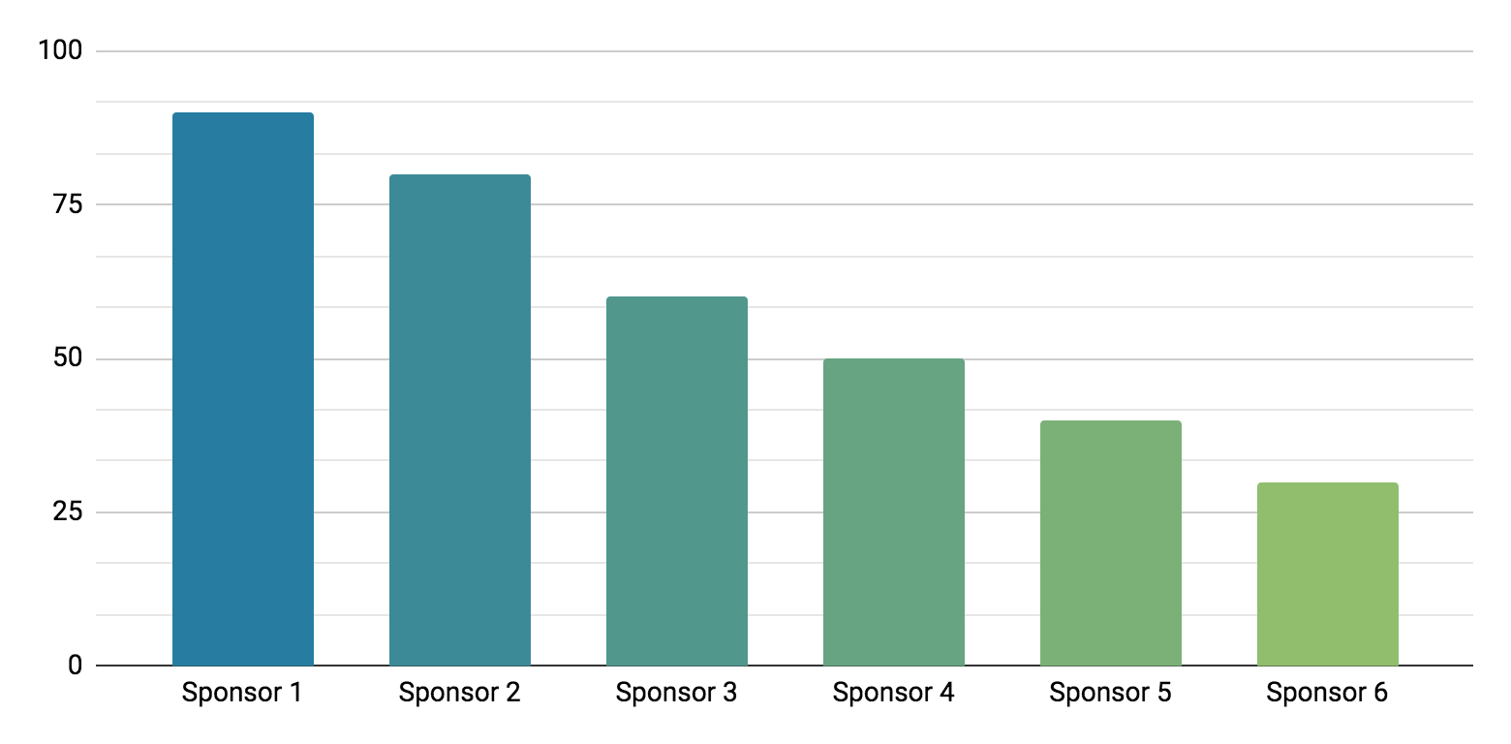
Project Charter Infographics
Sponsor authority levels
Mercury is the closest planet to the Sun and the smallest one of all the planets in the entire Solar System
$8,000
Initial budget
90%
80%
60%
50%
40%
30%
Team members
Project director
Project leader
Project manager
Name 1
Name 2
Name 3
Follow the link in the graph to modify its data and then paste the new one here. For more info, click here

Slide 24
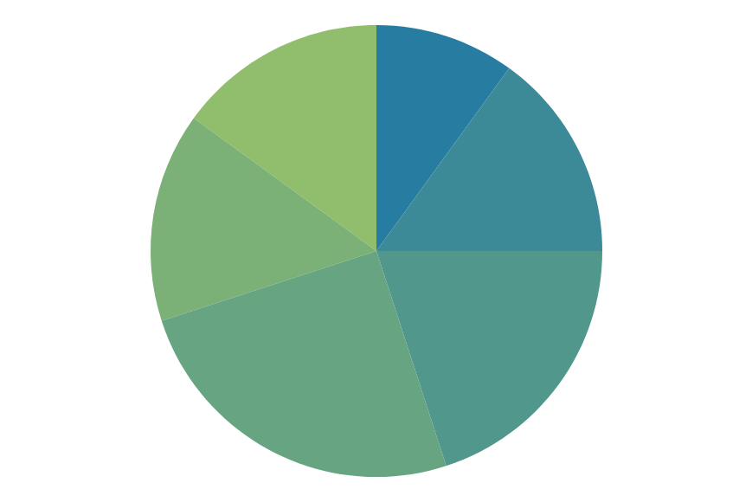
Project Charter Infographics
Project title
Mercury is the closest planet to the Sun and the smallest one in the entire Solar System
Risks
Despite being red, Mars is cold
Mercury
Venus
Project director
3/5
10%
15%
Name 1
Mars
Saturn
Project manager
2/5
20%
5%
Name 2
Jupiter
Earth
Team manager
1/5
15%
15%
Name 3
Follow the link in the graph to modify its data and then paste the new one here. For more info, click here

Slide 25
Project Charter Infographics
Project title
Milestones
Initiate | 09/04/2022
Plan | 09/05/2022
Execute | 12/06/2022
Control | 10/08/2022
Close | 11/09/2022
Problem statement
Mercury is the closest planet to the Sun and the smallest one
Project goals
Jupiter is a gas giant and the biggest planet of them all
Scope
Venus has a beautiful name and is the second planet from the Sun
Estimated benefits
Yes, Saturn is a gas giant and has several rings

Slide 26
Project Charter Infographics
Project name
Lead project
Project milestones
Mercury
Jupiter
Mercury is the closest planet to the Sun and the smallest one of all the planets in the entire Solar System
Approvals
Name | Role | Date
Name 1 | Project director | 10/09/2021
Name 2 | Project Manager | 10/09/2021
Neptune
01
Neptune is the farthest planet from the Sun
Mars
02
Despite being red, Mars is a cold place
Pluto
03
Pluto is considered a dwarf planet

Slide 27
Project Charter Infographics
Project description | Mercury is the closest planet to the Sun and the smallest one in the Solar System
Deliverables
Risks
Scope | Venus has a beautiful name and is the second planet from the Sun
Out of scope | Jupiter is a gas giant and the biggest planet of them all
Saturn
Neptune
Deliverable 1
Deliverable 2
Deliverable 3
Deliverable 4
Deliverable 5
Deliverable 6
Deliverable 7
Deliverable 8
55%
45%
Mercury
Venus

Slide 28
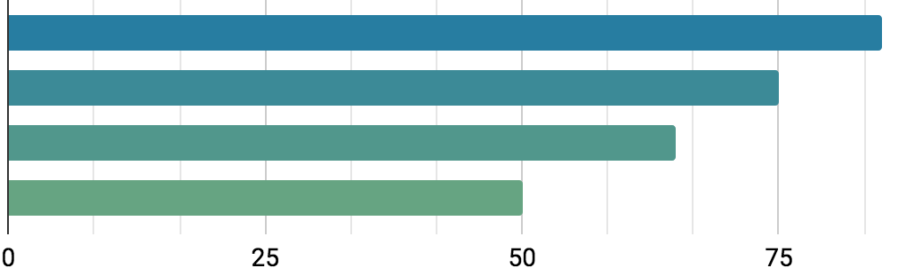
Project Charter Infographics
Project director
$120,234
Business case
Initial budget
Name 1
Mercury is the closest planet to the Sun and the smallest one
Sponsors
Mercury
Venus
Saturn
Jupiter
85%
75%
65%
50%
Follow the link in the graph to modify its data and then paste the new one here. For more info, click here

Slide 29
Project Charter Infographics
Project director
Project title
Mercury is the closest planet to the Sun and the smallest one of all the planets in the Solar System. This planet's name has nothing to do with the liquid metal
Name 1
Project manager
Name 2
Milestone 1
Milestone 2
Milestone 3
List item 1
List item 2
List item 3
List item 4
List item 1
List item 2
List item 3
List item 4
List item 1
List item 2
List item 3
List item 4
Jan | Feb | Mar | Apr | May | June | July | Aug | Sep | Oct | Nov | Dec

Slide 30
Project Charter Infographics
Goals
Initial budget
$9,640
01
Mercury
02
Mars
Venus is the second planet from the Sun
Saturn is a gas giant with several rings
Tasks | Date | Responsible | Approbal
Mercury is the smallest planet of them all | Oct 13 | Name 1
Jupiter is the biggest planet of them all | Nov 16 | Name 2
Despite being red, Mars is a cold place | Dec 23 | Name 3

Slide 31
Project Charter Infographics
Project timeline
Stakeholders
Interests
01
Venus has a beautiful name
It is the closest one to the Sun
Pluto is a small dwarf planet
02
It’s the third one from the Sun
Saturn is a gas giant with rings
Ceres is in the main asteroid
03
Despite being red, Mars is cold
Jupiter is the biggest planet
Earth harbors some life
04
Earth is where we all live on
It is one of the gas giants
It is named after a roman god

Slide 32
Project Charter Infographics
Project title
Mercury is the closest planet to the Sun
Goals
Despite being red, Mars is a cold planet
Resources
Venus is the second planet from the Sun
Business case
Earth is the planet where we all live on
Risk definition
Saturn is a gas giant with several rings
Sponsors
Mercury Mars
Approval requirement
Name / role
Budget
$72,345

Slide 33
Instructions for use
In order to use this template, you must credit Slidesgo in your final presentation.
You are allowed to:
- Modify this template.
- Use it for both personal and commercial projects.
You are not allowed to:
- Sublicense, sell or rent any of Slidesgo Content (or a modified version of Slidesgo Content).
- Distribute Slidesgo Content unless it has been expressly authorized by Slidesgo.
- Include Slidesgo Content in an online or offline database or file.
- Offer Slidesgo templates (or modified versions of Slidesgo templates) for download.
- Acquire the copyright of Slidesgo Content.
For more information about editing slides, please read our FAQs or visit Slidesgo School:
https://slidesgo.com/faqs and https://slidesgo.com/slidesgo-school

Slide 34
Instructions for use (premium users)
If you are a Premium user on Slidesgo, you can use this template without attribution.
You are allowed to:
Modify this template.
Use it for both personal and commercial purposes.
Hide or delete the “Thanks” slide and the mention to Slidesgo in the credits.
Share this template in an editable format with people who are not part of your team.
You are not allowed to:
Sublicense, sell or rent this Slidesgo Template (or a modified version of this Slidesgo Template).
Distribute this Slidesgo Template (or a modified version of this Slidesgo Template) or include it in a database or in any other product or service that offers downloadable images, icons or presentations that may be subject to distribution or resale.
Use any of the elements that are part of this Slidesgo Template in an isolated and separated way from this Template.
Register any of the elements that are part of this template as a trademark or logo, or register it as a work in an intellectual property registry or similar.
For more information about editing slides, please read our FAQs or visit Slidesgo School:
https://slidesgo.com/faqs and https://slidesgo.com/slidesgo-school

Slide 35
Infographics
You can add and edit some infographics to your presentation to present your data in a visual way.
Choose your favourite infographic and insert it in your presentation using Ctrl C + Ctrl V or Cmd C + Cmd V in Mac.
Select one of the parts and ungroup it by right-clicking and choosing “Ungroup”.
Change the color by clicking on the paint bucket.
Then resize the element by clicking and dragging one of the square-shaped points of its bounding box (the cursor should look like a double-headed arrow). Remember to hold Shift while dragging to keep the proportions.
Group the elements again by selecting them, right-clicking and choosing “Group”.
Repeat the steps above with the other parts and when you’re done editing, copy the end result and paste it into your presentation.
Remember to choose the “Keep source formatting” option so that it keeps the design. For more info, please visit Slidesgo School.

